Slide 1
Accident and Vehicle Analysis report
Alphas

Slide 2
Introduction
This dataset provides comprehensive records of road accidents, including occurrences, vehicles, road characteristics, geographical locations, vehicle types, severity, and timestamps, aimed at improving safety and minimizing societal impact.
By analyzing these interconnected factors, we aim to extract valuable insights that can inform policy decisions, enhance infrastructure planning, and ultimately save lives.
Risk Assessment Specialists analyze data to determine risk levels for specific locations using GIS, historical disaster data, and actuarial models, utilizing tools such as GIS for risk assessment.
Policy Services or Customer Service Representatives may notify policyholders of a property's high-risk zone after completing a risk assessment, providing crucial information about risk factors and advising on potential coverage options or mitigation measures.

Slide 3
Data Handling
Two datasets were initially combined to include accident information and vehicle information from the car involved in the accident. However, some columns had no entries or information about the accident. Some columns had null values less than 20% of the data, between 20% and 80% of the data, and above 80% of the data. These columns had no entries and no entries.
The study used measures of central tendency to fill in null values on features with less than 20%. For features with null values between 20% and 80%, machine learning models like KNN, LM, and GLM were used. Columns with null values above 80% were dropped to avoid bias and mis-accuracy. For variables with geographical positions, a kNN model was used to impute the null values.
The study found that some features had no null values, but most entries were marked as "data missing or out of range." Some columns were left as they were, while measures of central tendency were used to replace missing values in columns that did not make sense.
The data contained no duplicate variables and no discrepancy.

Slide 4
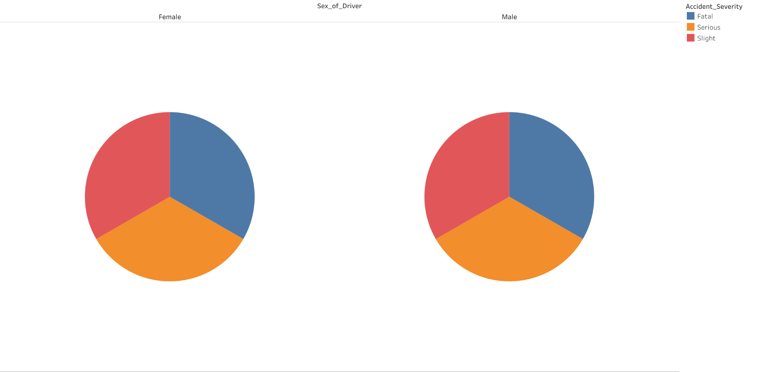
General Distribution of Accident Severity

Slide 5
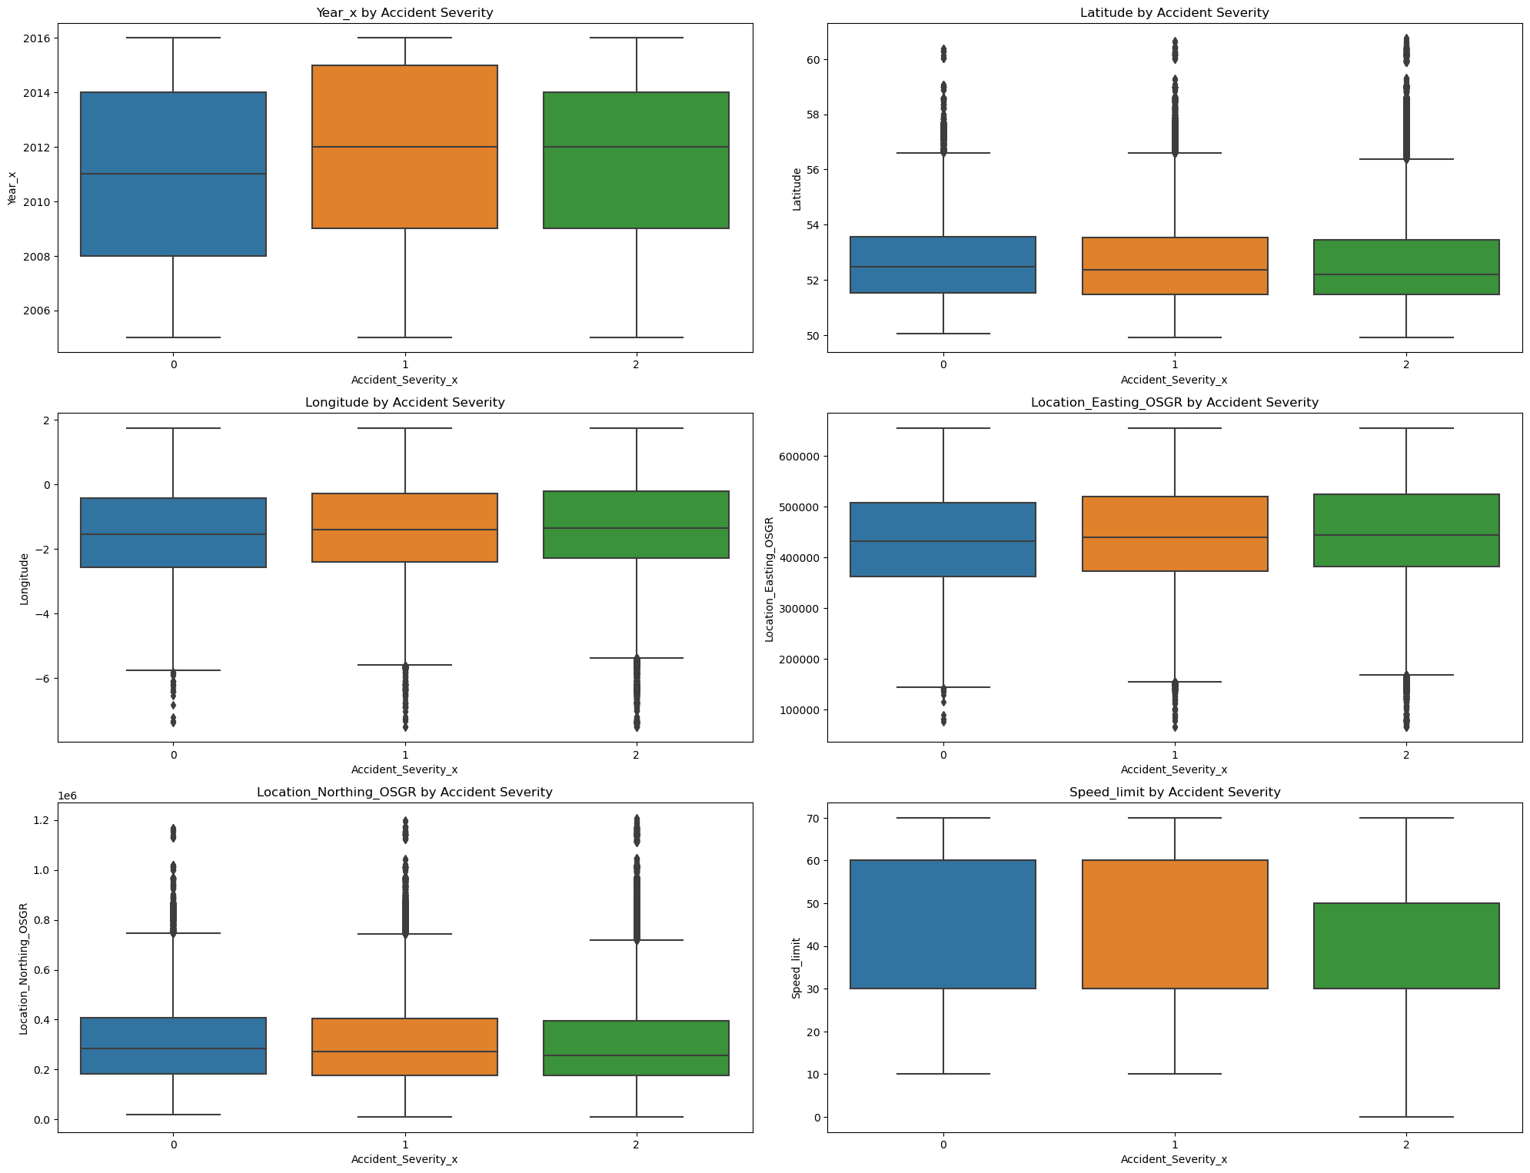
General Distribution of the Location

Slide 6
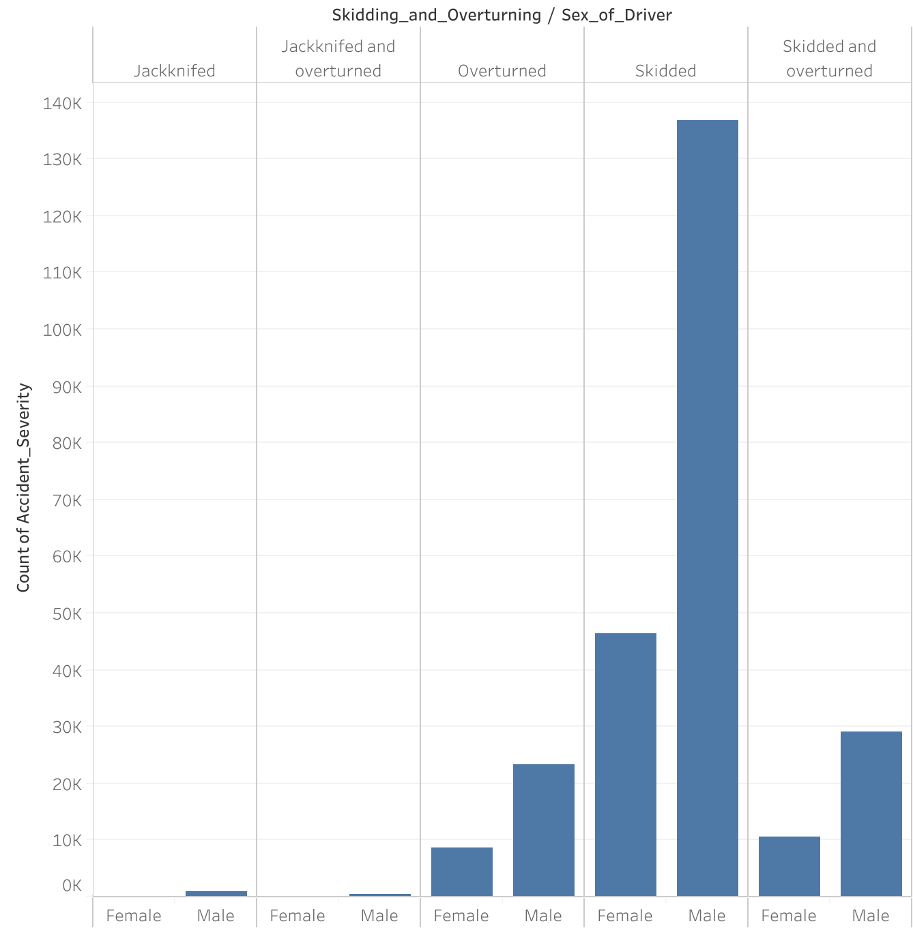
The Nature of the Accident based on Gender

Slide 7
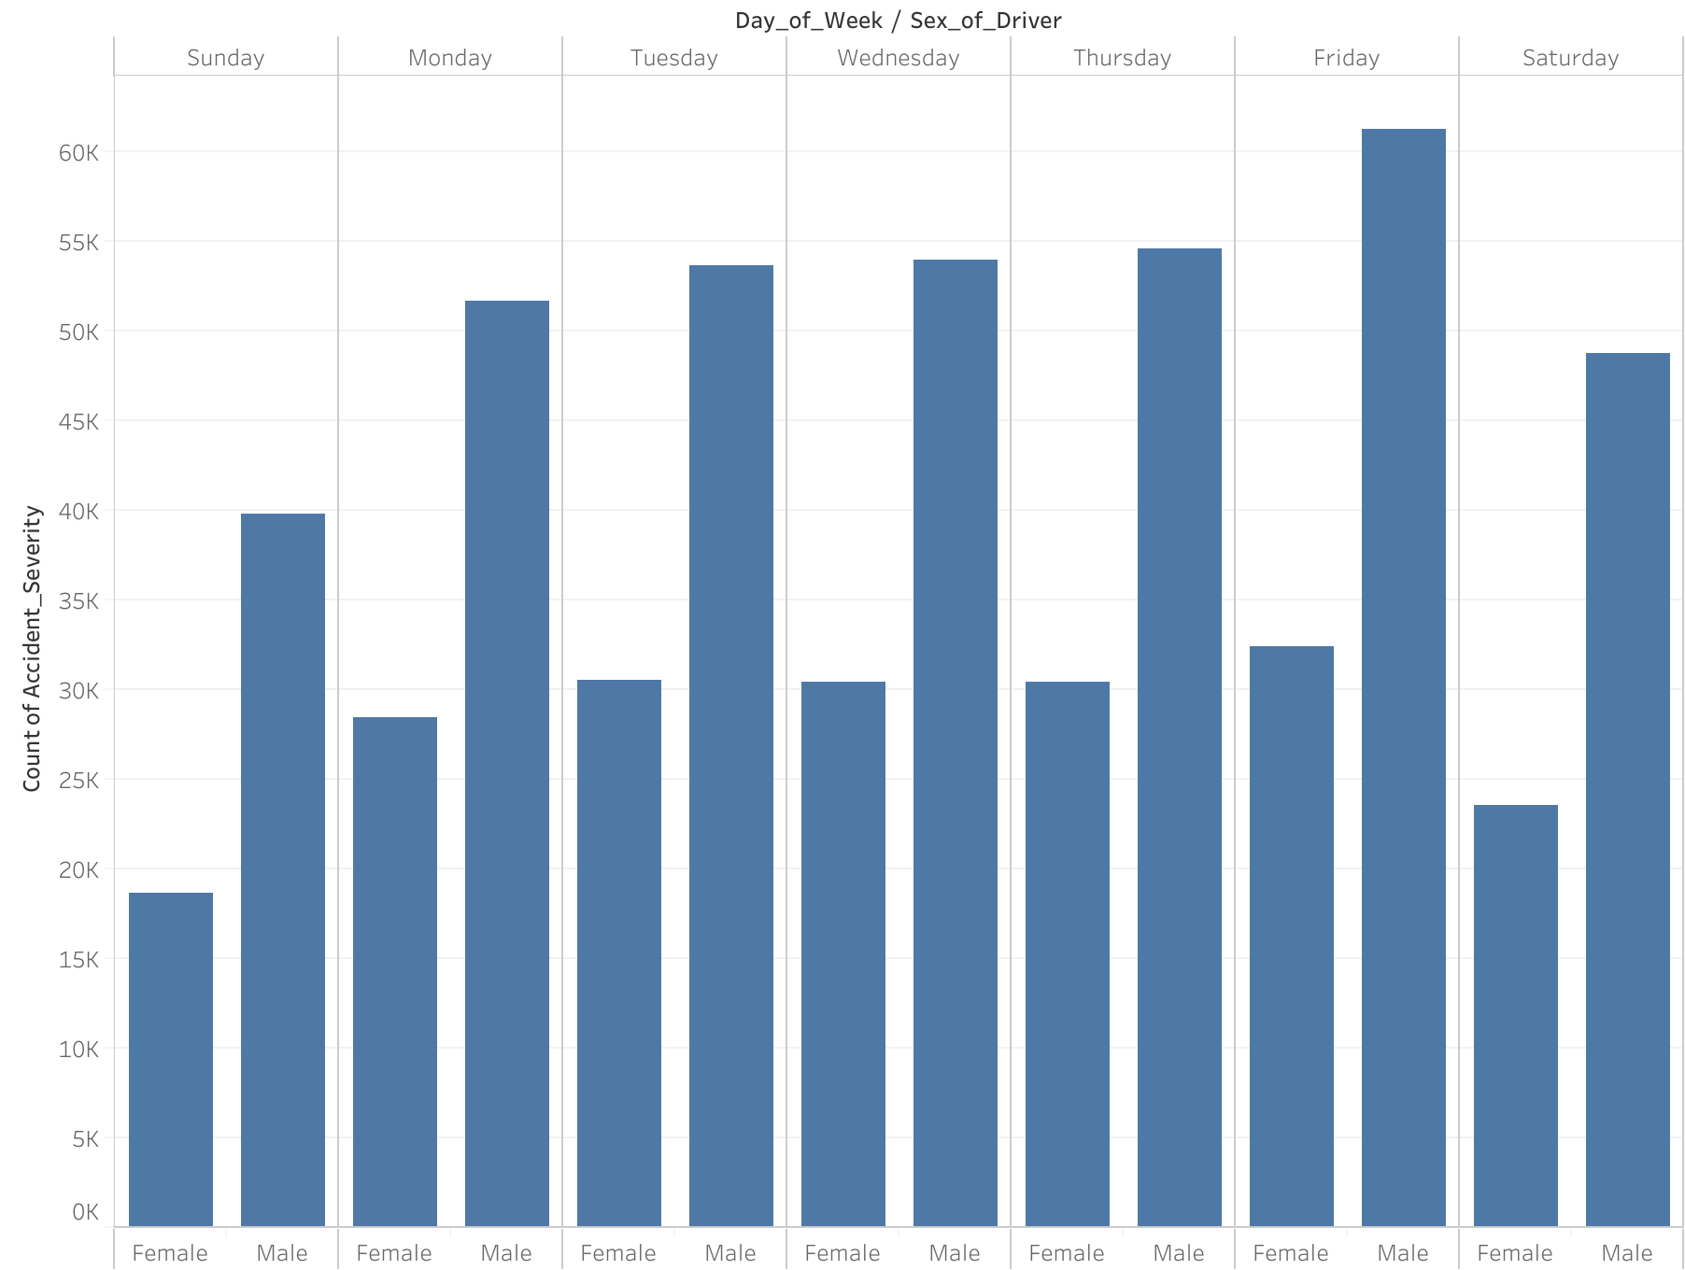
Accident Severity Per Weekday

Slide 8
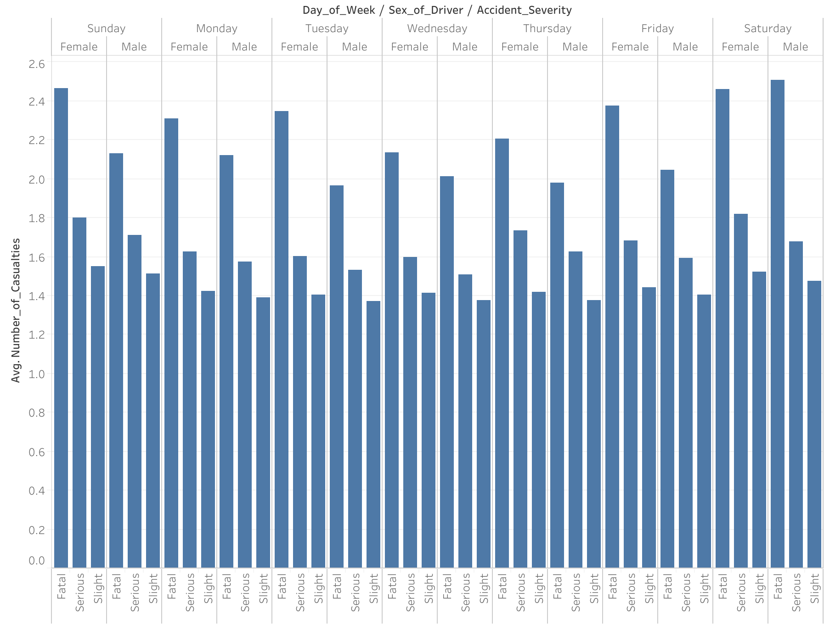
Accident Severity Based on Gender Per Weekday

Slide 9
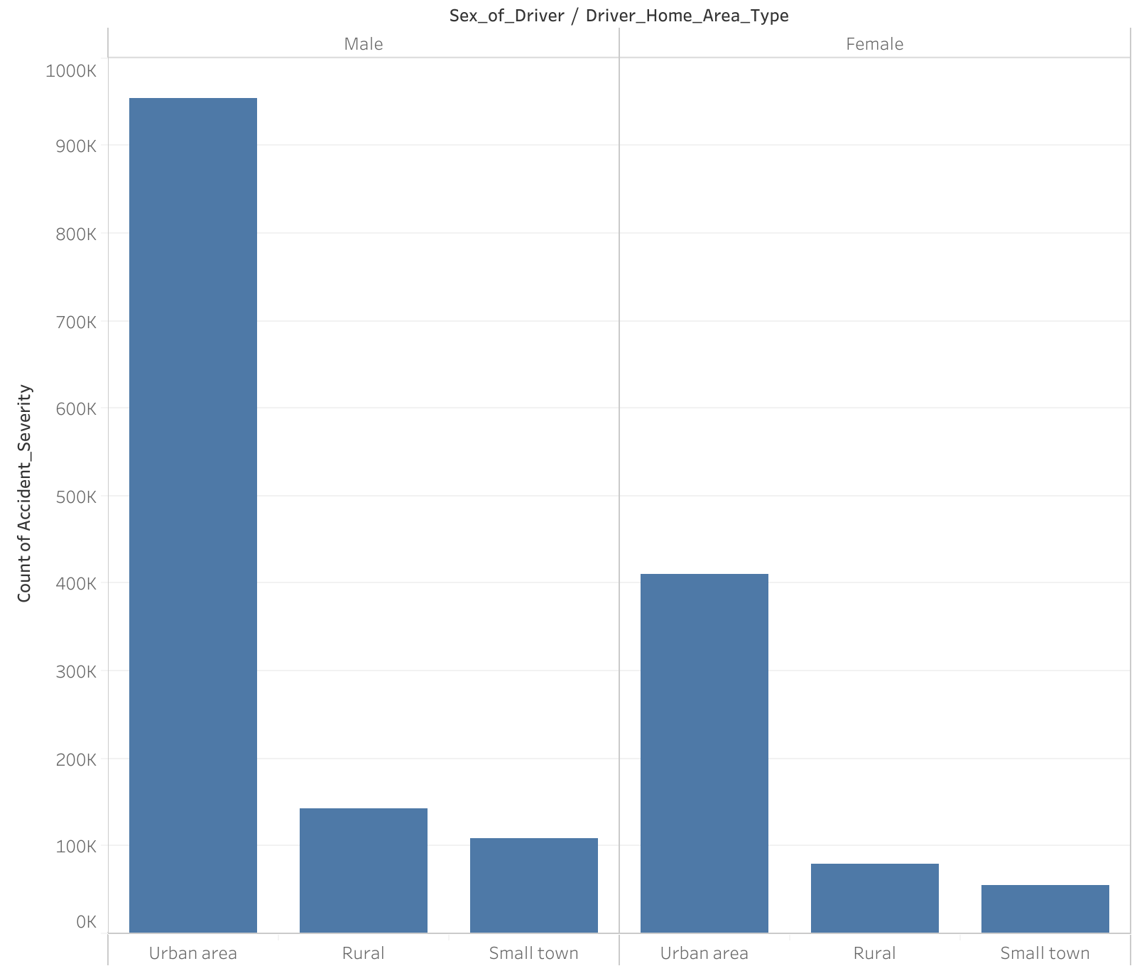
Accident Severity based on the Area

Slide 10
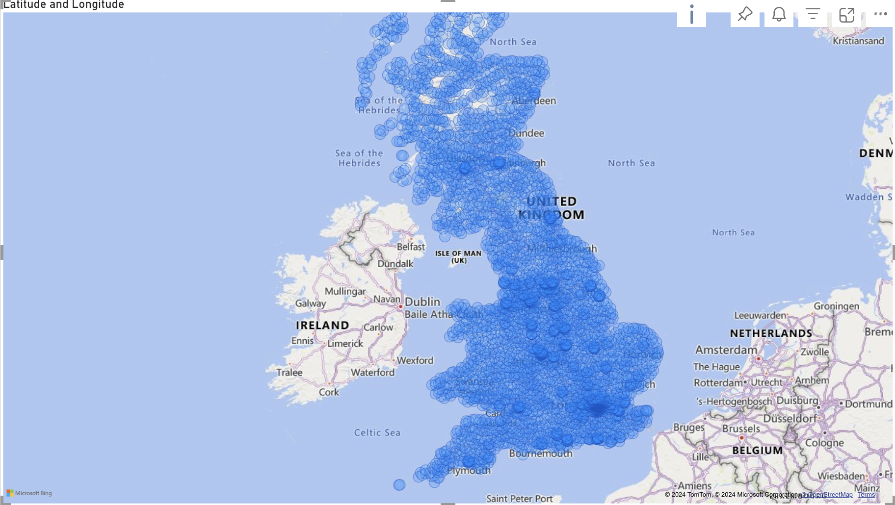
Location of Accident

Slide 11
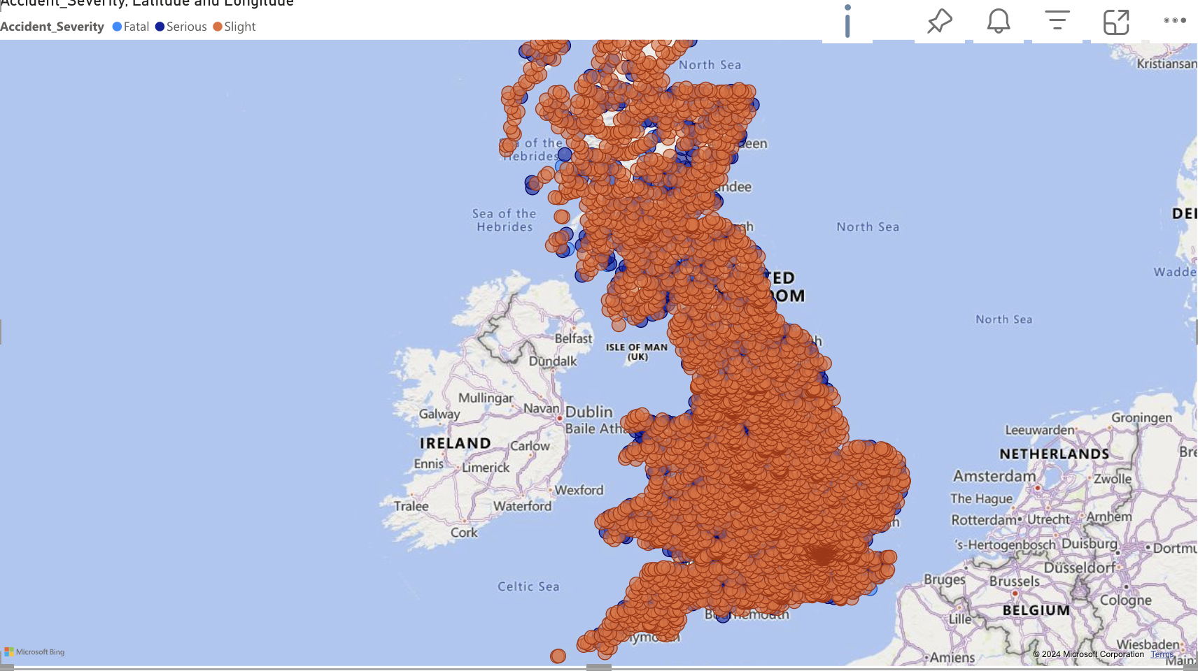
Location of Accident

Slide 12
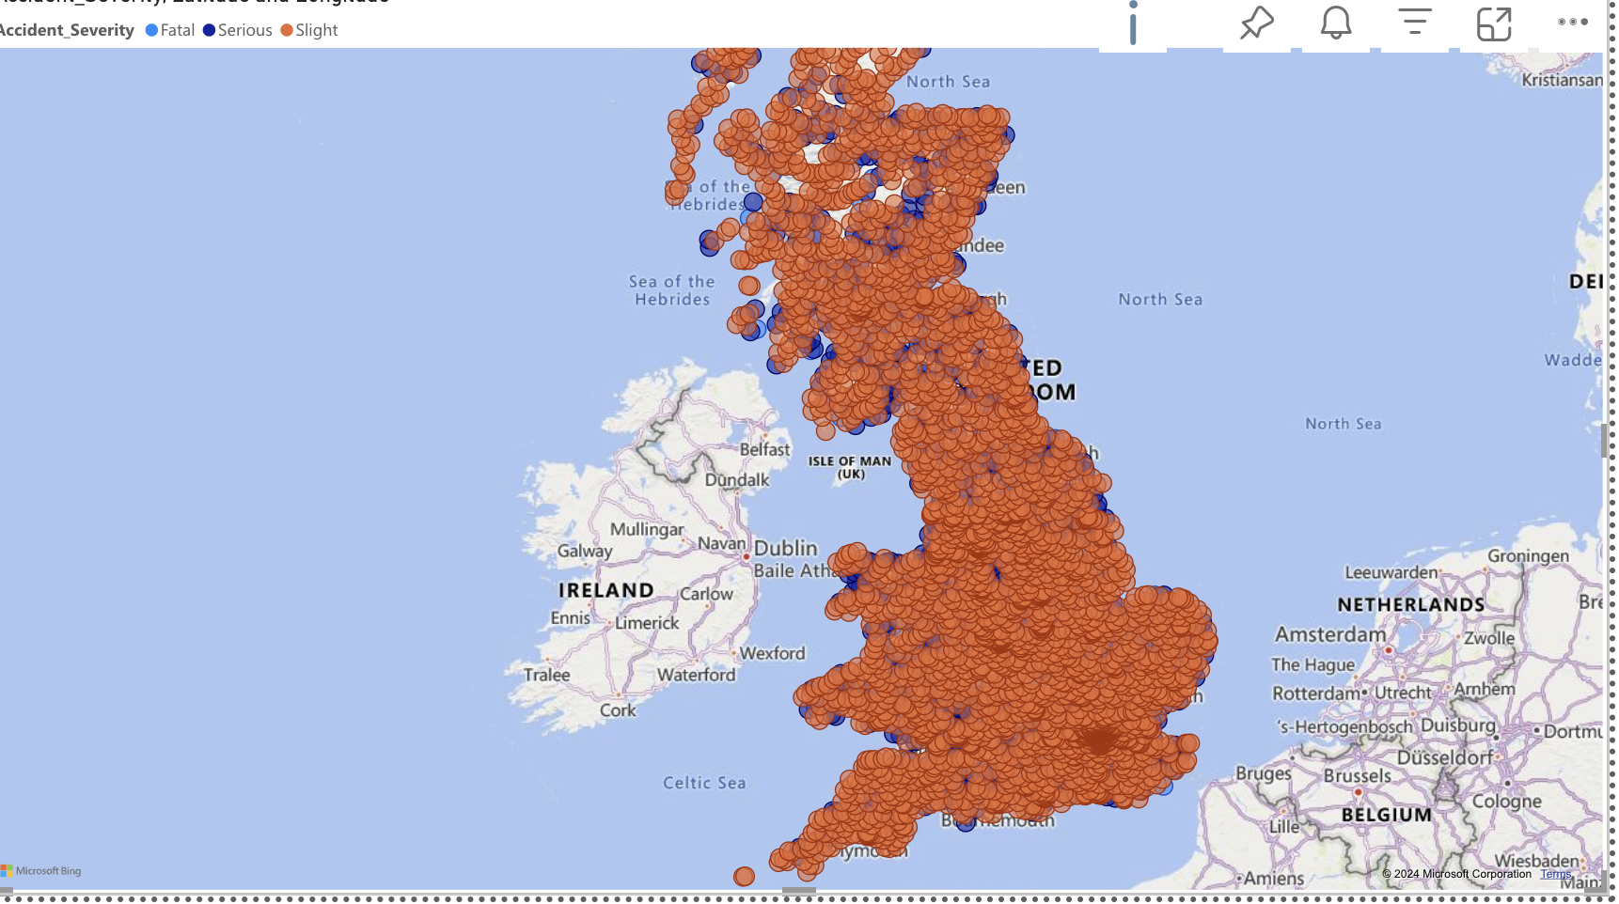
Location of Accident

Slide 13
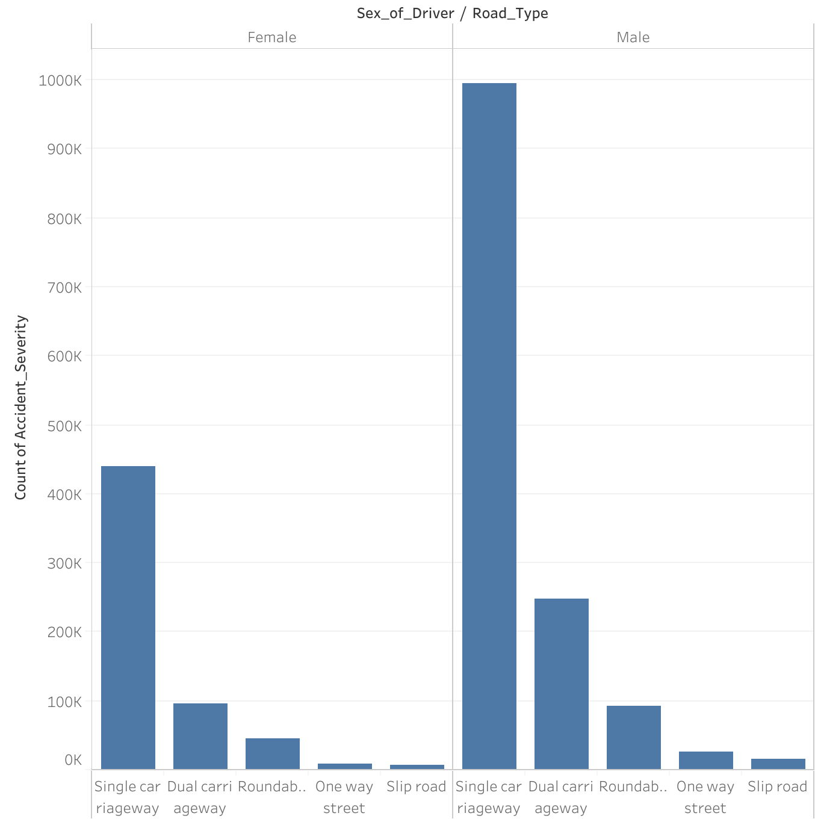
Road type based on Accident Severity

Slide 14
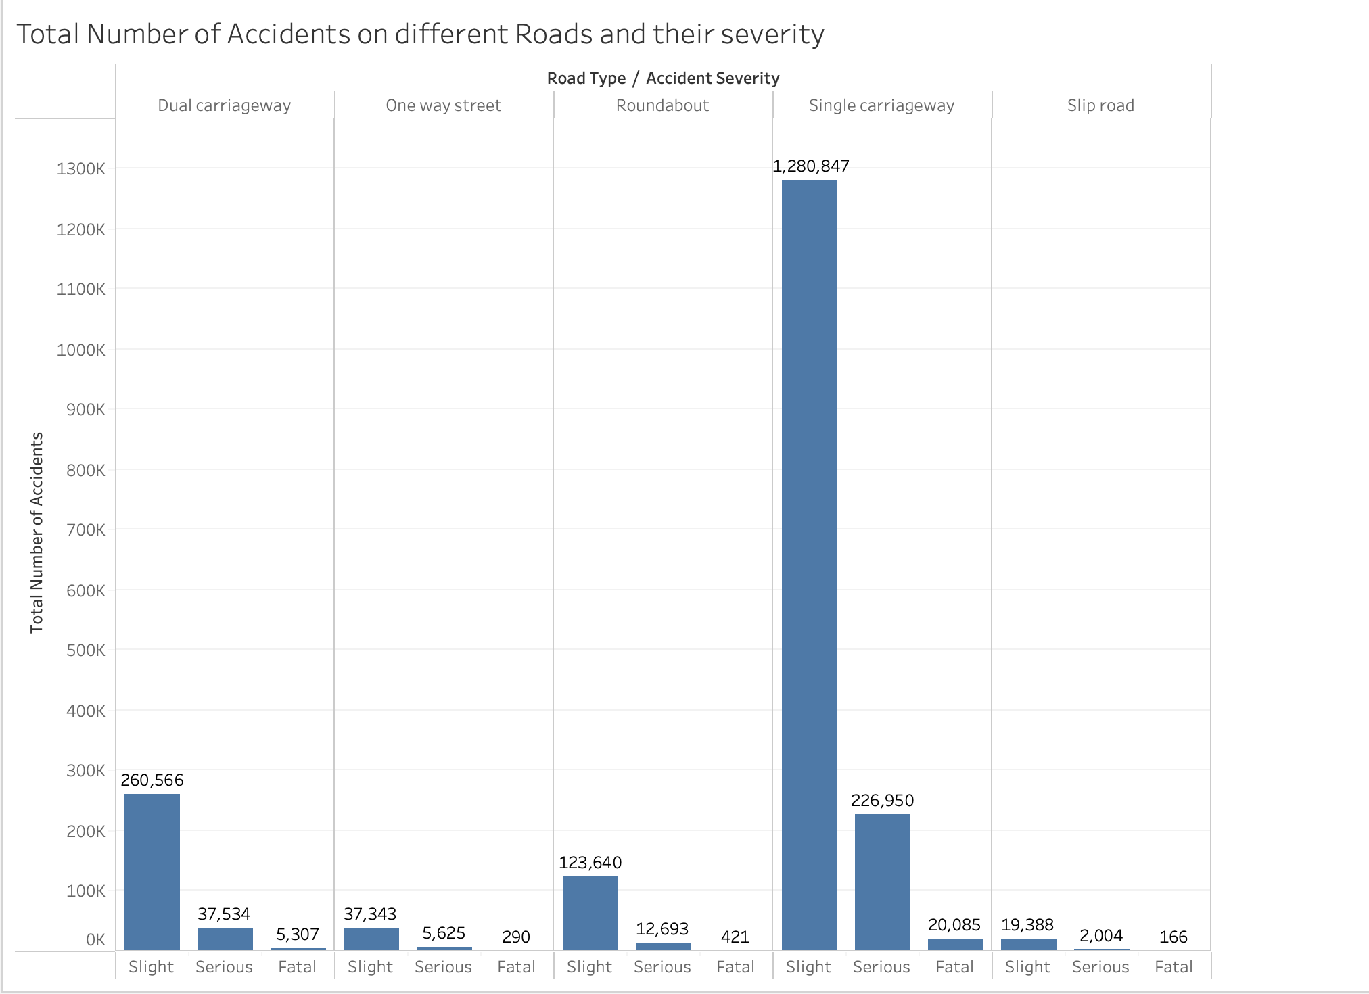
Accident Severity based on the road type

Slide 15
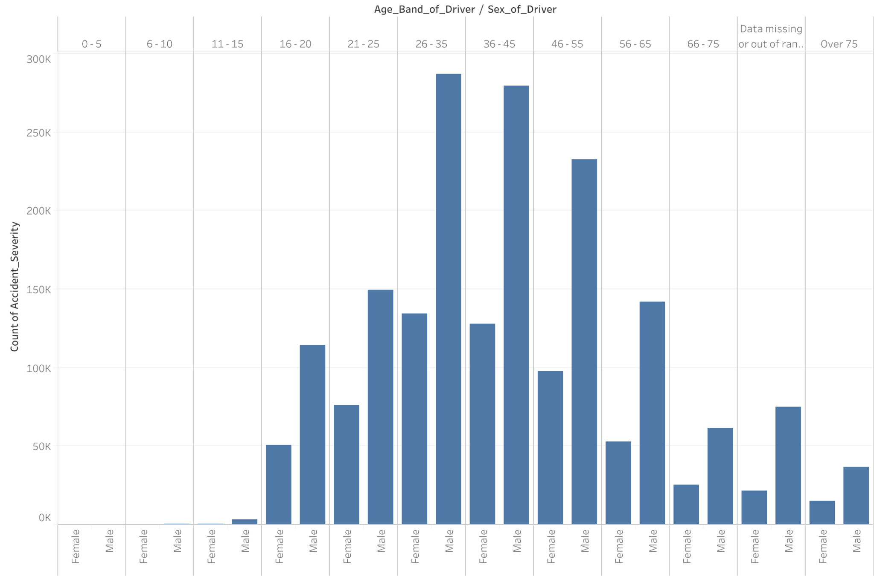
Accident Severity based on the Age of Drivers

Slide 16
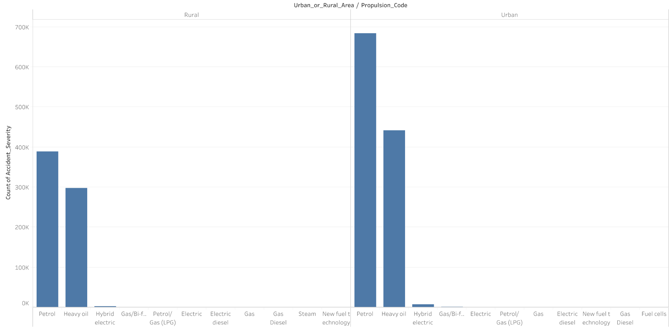
Accident Severity based on the Type of Vehicle

Slide 17
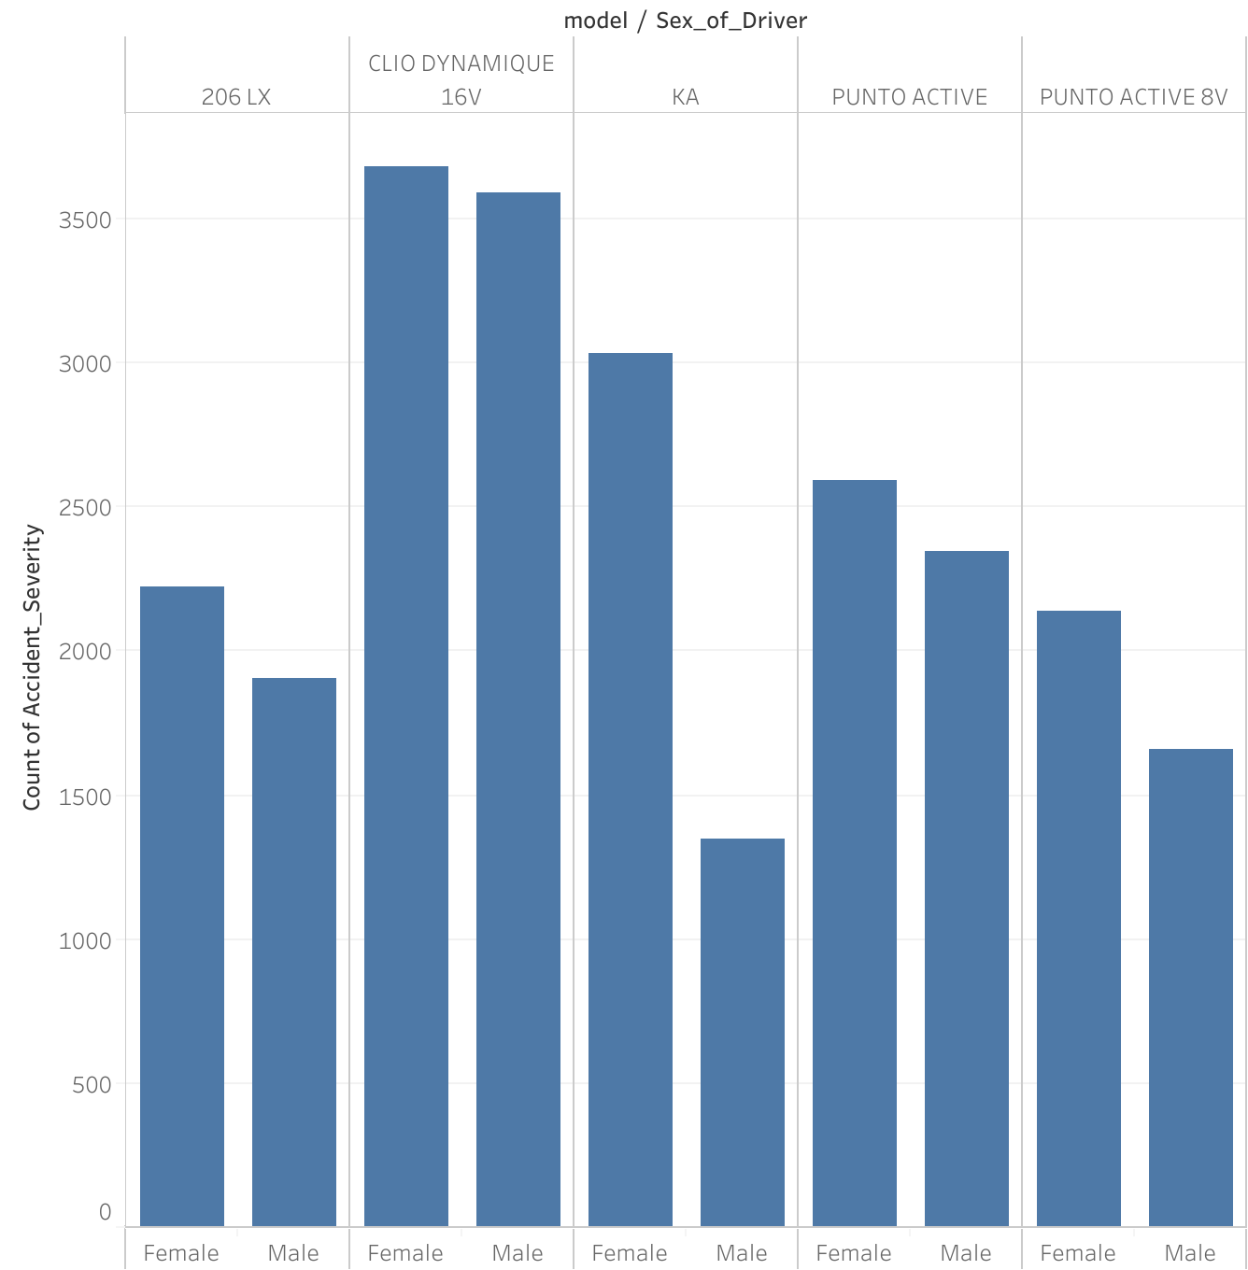
Accident Severity based on Vehicle Model

Slide 18
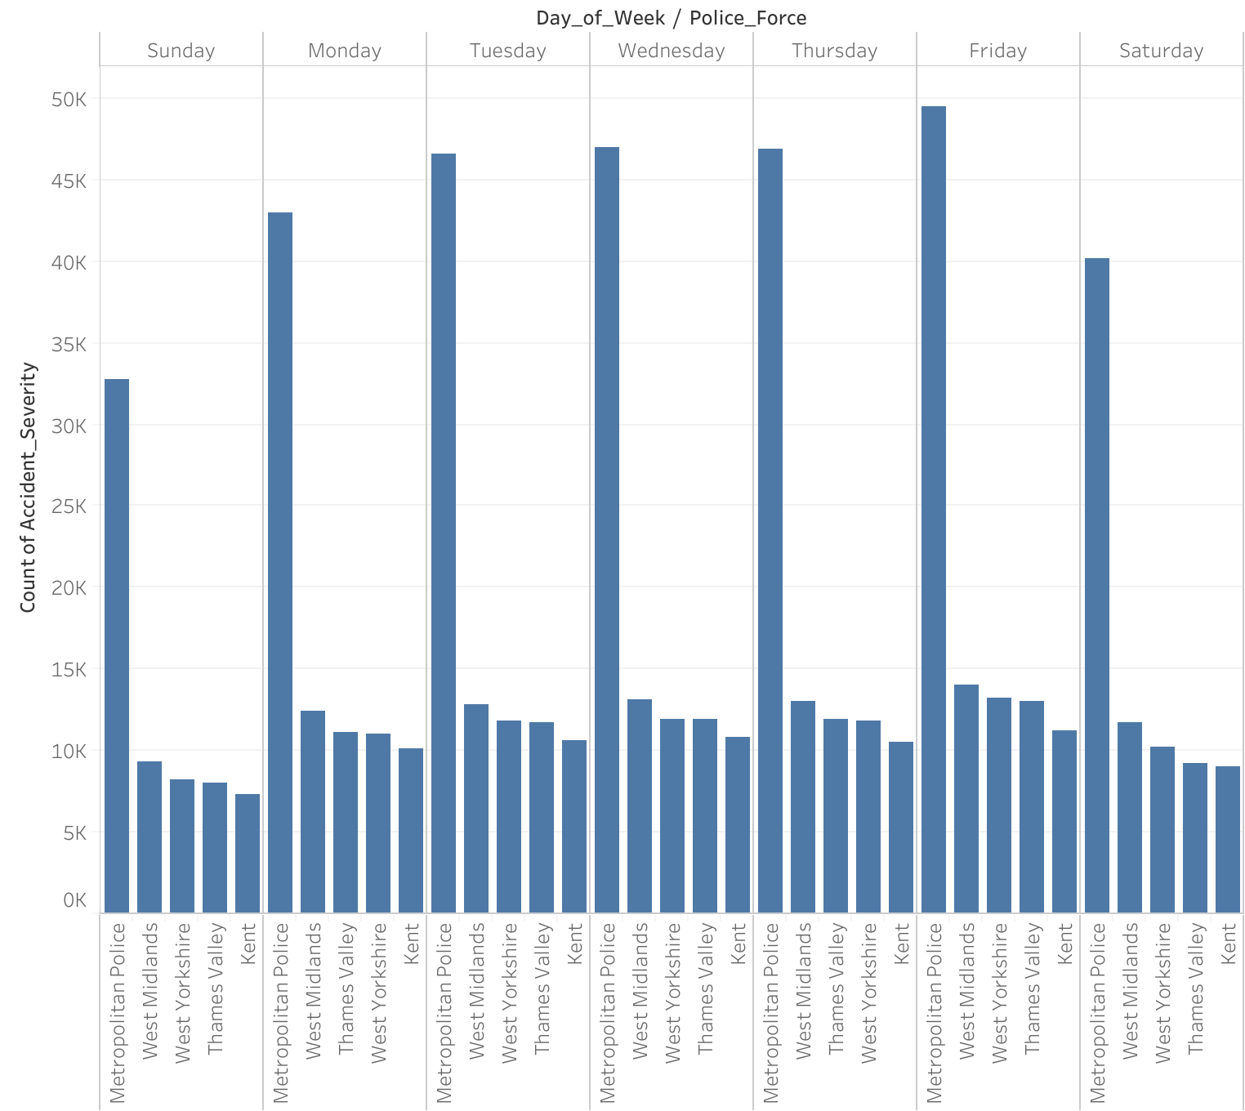
Police Assistance On Weekdays

Slide 19
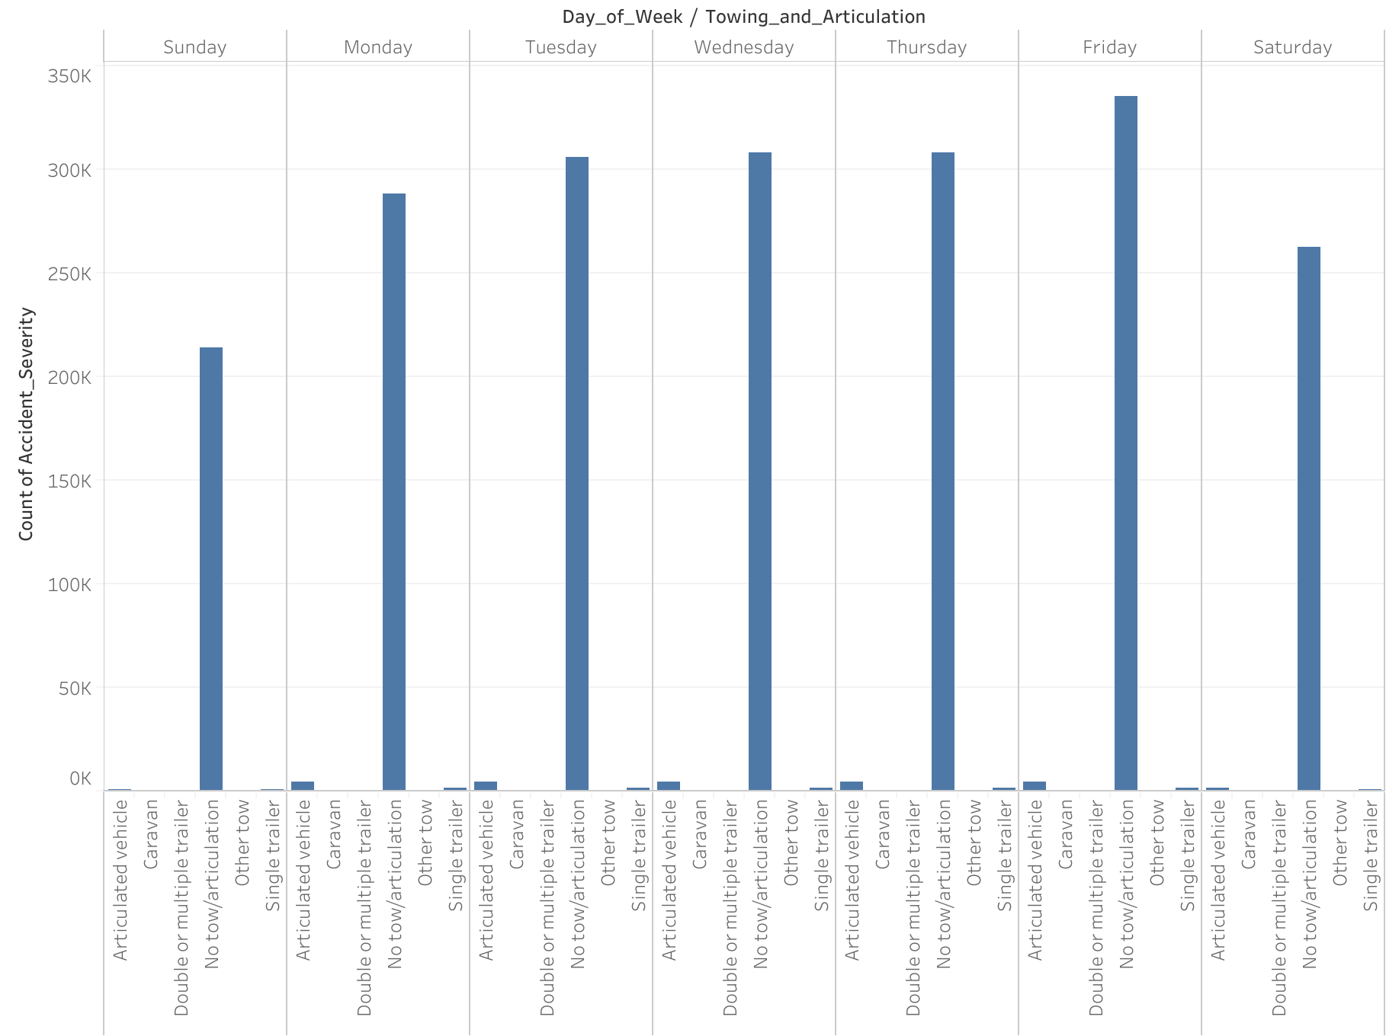
Towing Service Per Week Day

Slide 20


